Slide 1

Employee Management System
Presented By
Dayal Chimnani & Himanshu Mandiya

Slide 2
Introduction
An employee management system is a software, that helps your employees to give their best efforts every day to achieve the goals of your organization. It guides and manages employee’s efforts in the right direction. It also securely stores and manages personal and other work-related details for your employees. In the employee management system, you can manage admin activities in an easier and quicker way. Employees are an important part of your organization it is their work that ultimately contributes to the bottom line of the company. It is an important part of HR management. It also helps to employee engagement and employee retention brings down costs and increases productivity.

Slide 3
Technology Used
We used Java Spring-Boot as backend and React JS as Frontend in our Project.
Spring-Boot :–
The main goal of the Spring Boot framework is to reduce overall development time and increase efficiency. React has become the first choice for frontend because it gives developers the ability to work with a virtual browser (more friendly than the real browser). Also, a JavaScript developer can become a productive developer in a few hours because there is a small API to learn, a few functions, and how to use them…
React :–
React allows developers to create large web applications that can change data, without reloading the page. The main purpose of React is to be fast, scalable, and simple. Spring

Slide 4


User Classes
EMPLOYEE
Admin
In this module employee can update the details like personal, previous employer, bank details and many more, apply for leave.
In this module Admin can Add employee ,Update employee, Delete employee and Manage dashboard.

Slide 5
Product Functions
01
The system provides efficient way to use the services by Employee and Admin.
The system provides easy interface that users can easily update their information.
02
System provides better ways to manage their information like Personal, Job Information , Bank Information and many more.
03
This System also Help Employees Develop Skills.
04
05
This system provides Better Employee-Manager Relationship.

Slide 6
Employee
After successful registration ,the employee
Employee can see the all the details like Data of joining, designation Reported by and status.
Can edit his/her profile ,
Apply for leave

Slide 7
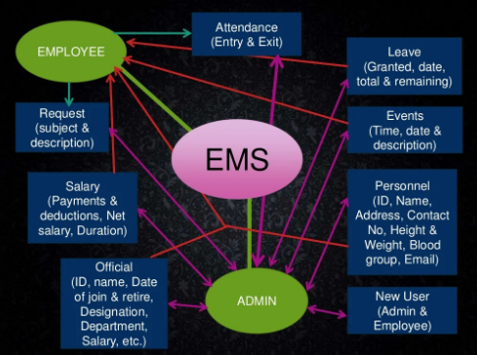
Use Case diagram for Admin and Employee

Slide 8
Employee Management System Module
Admin : The admin will be the chairman of the organization and will have access to the whole system. The admin can add or remove any user from the system while it will provide the user ID and password to the user at the time of login.
Login : The user will get access to the system only after they will enter the password and ID provided by the admin. Register: The user needs to provide the information to get registered into the system. Details: this module will provide the details of each employee who is working in the organization. Help : This will provide instruction about different options provided in the system.

Slide 9
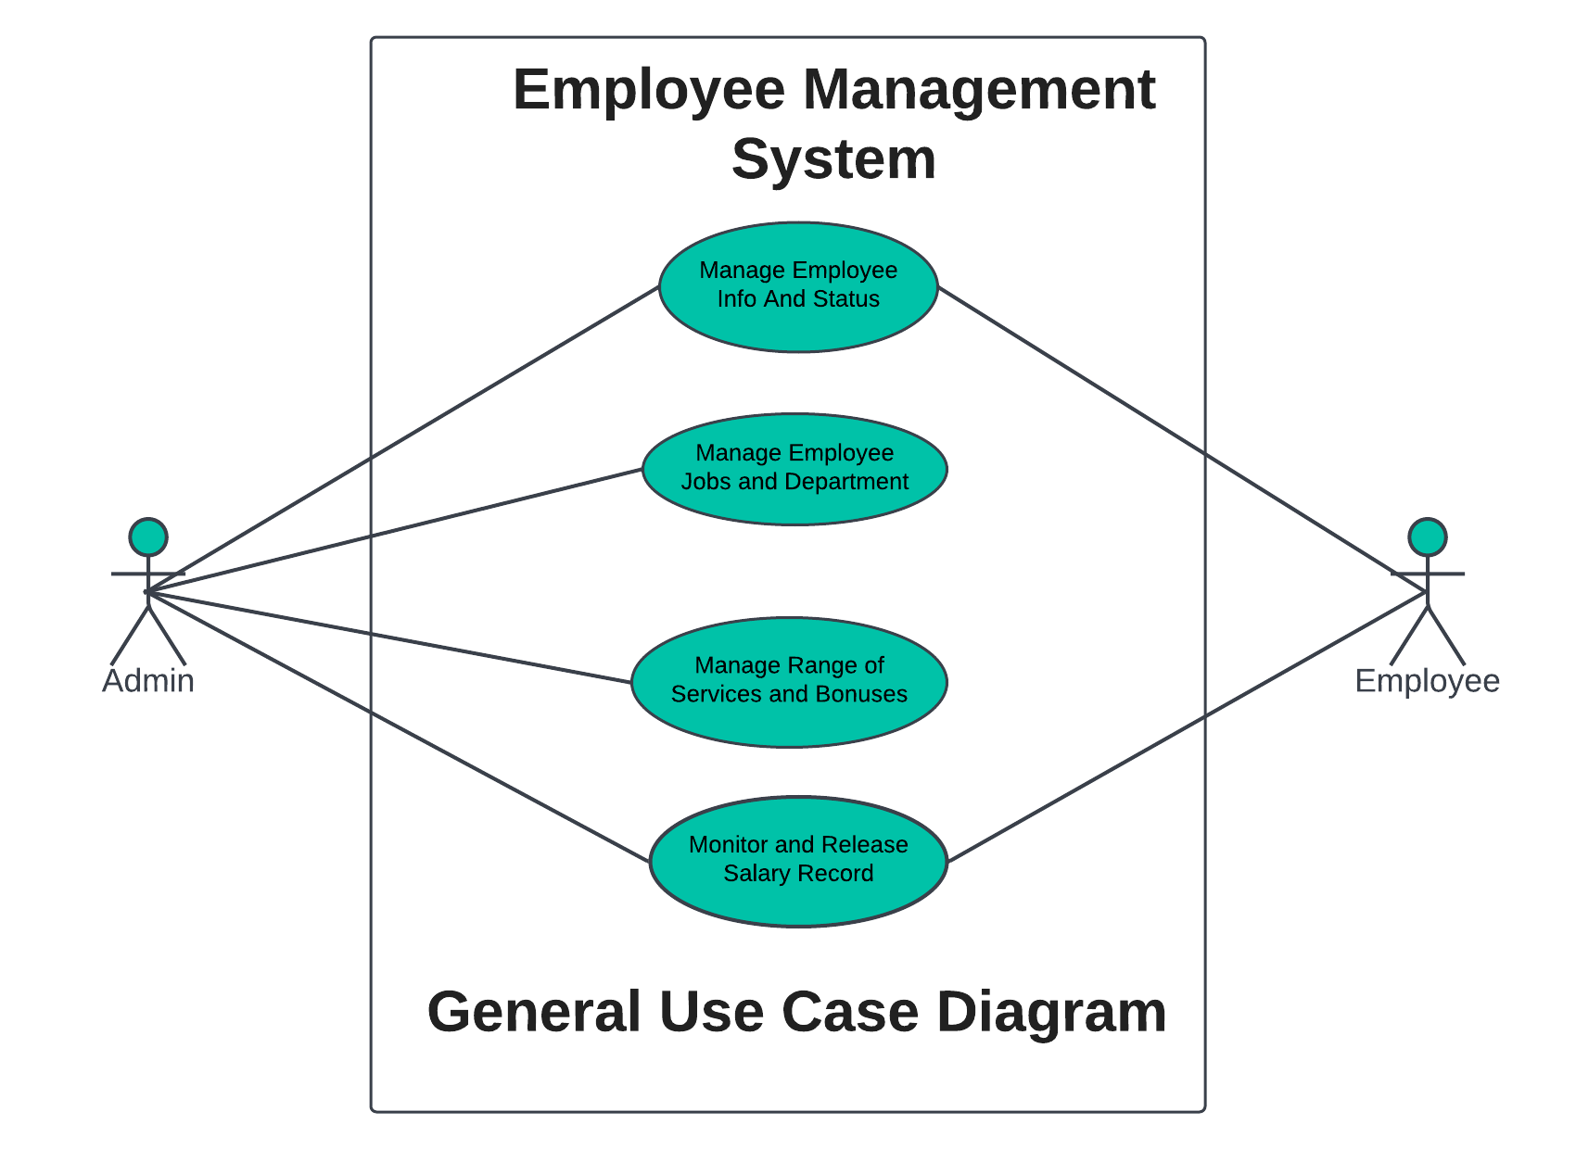
Use Case diagram for Employee

Slide 10
Admin Module
The Admin can
Approve or disapprove the leave.
He /she can see employee details ,
Manage account and delete employee account.

Slide 11
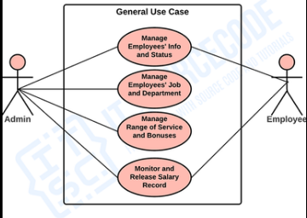
Use Case diagram for Admin

Slide 12
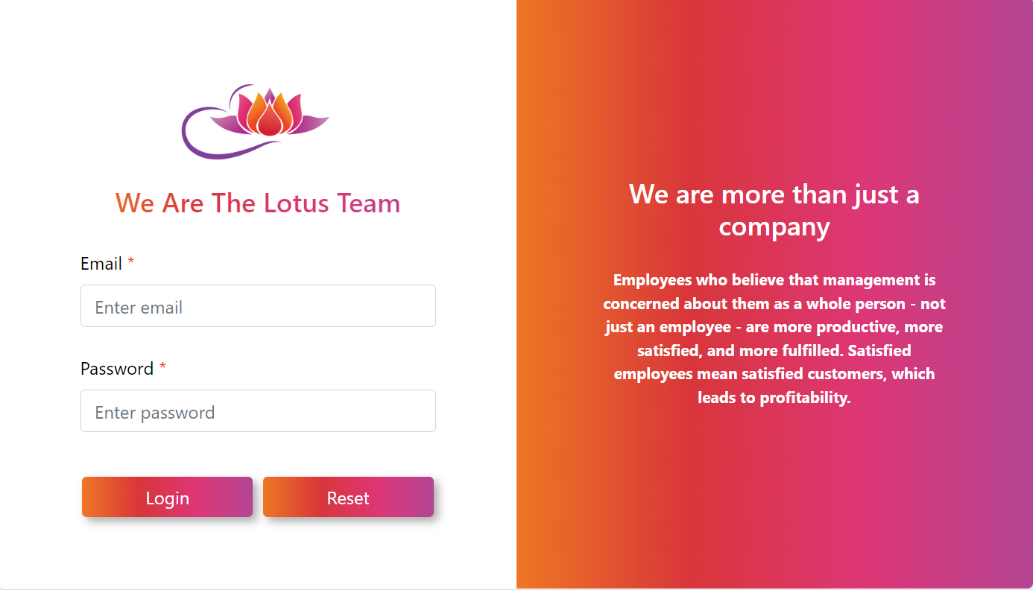

Slide 13
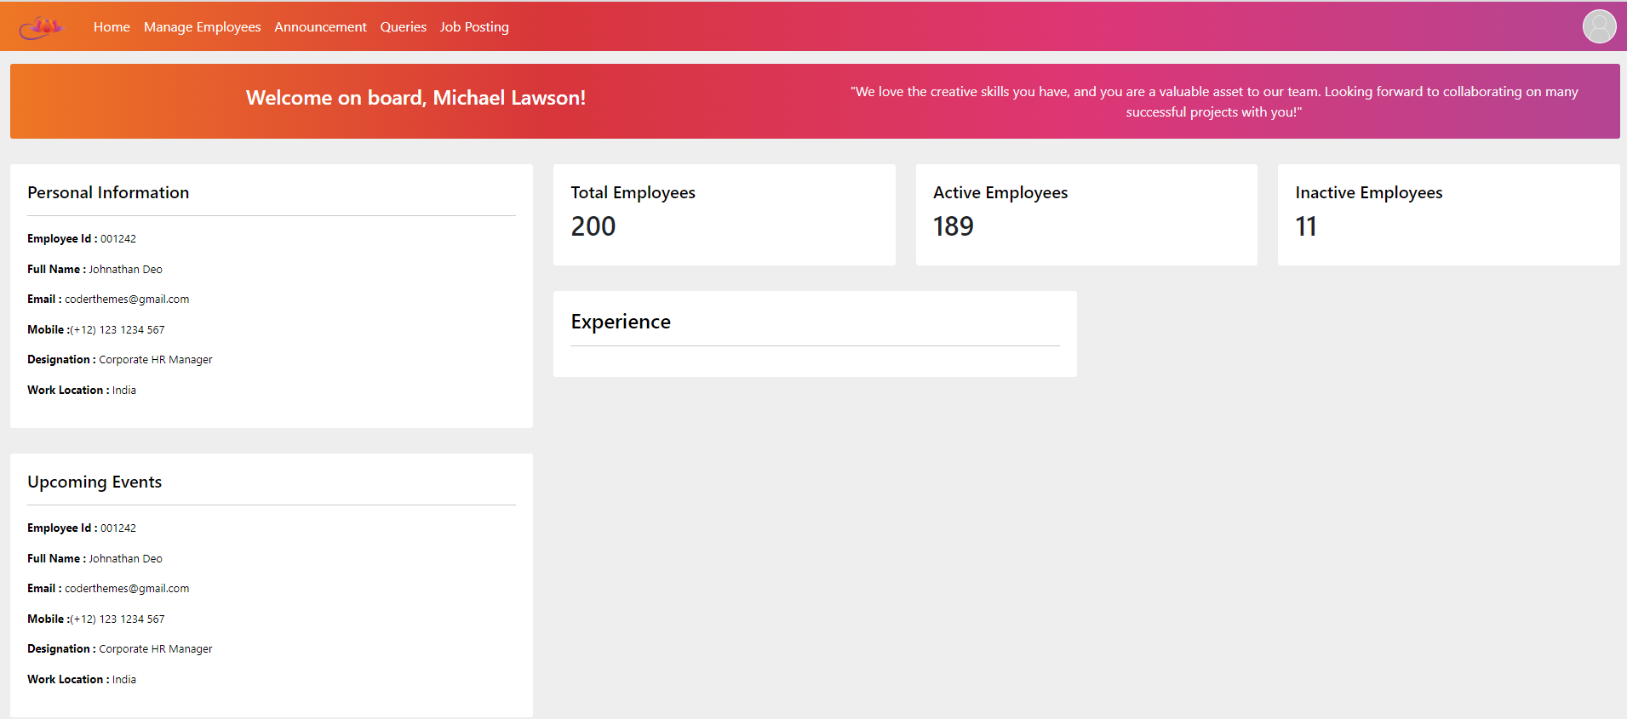

Slide 14
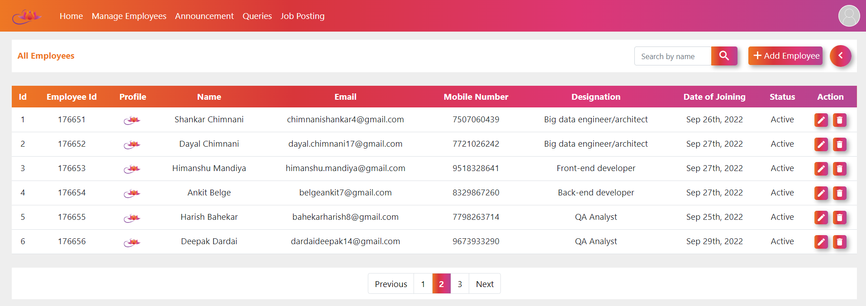

Slide 15
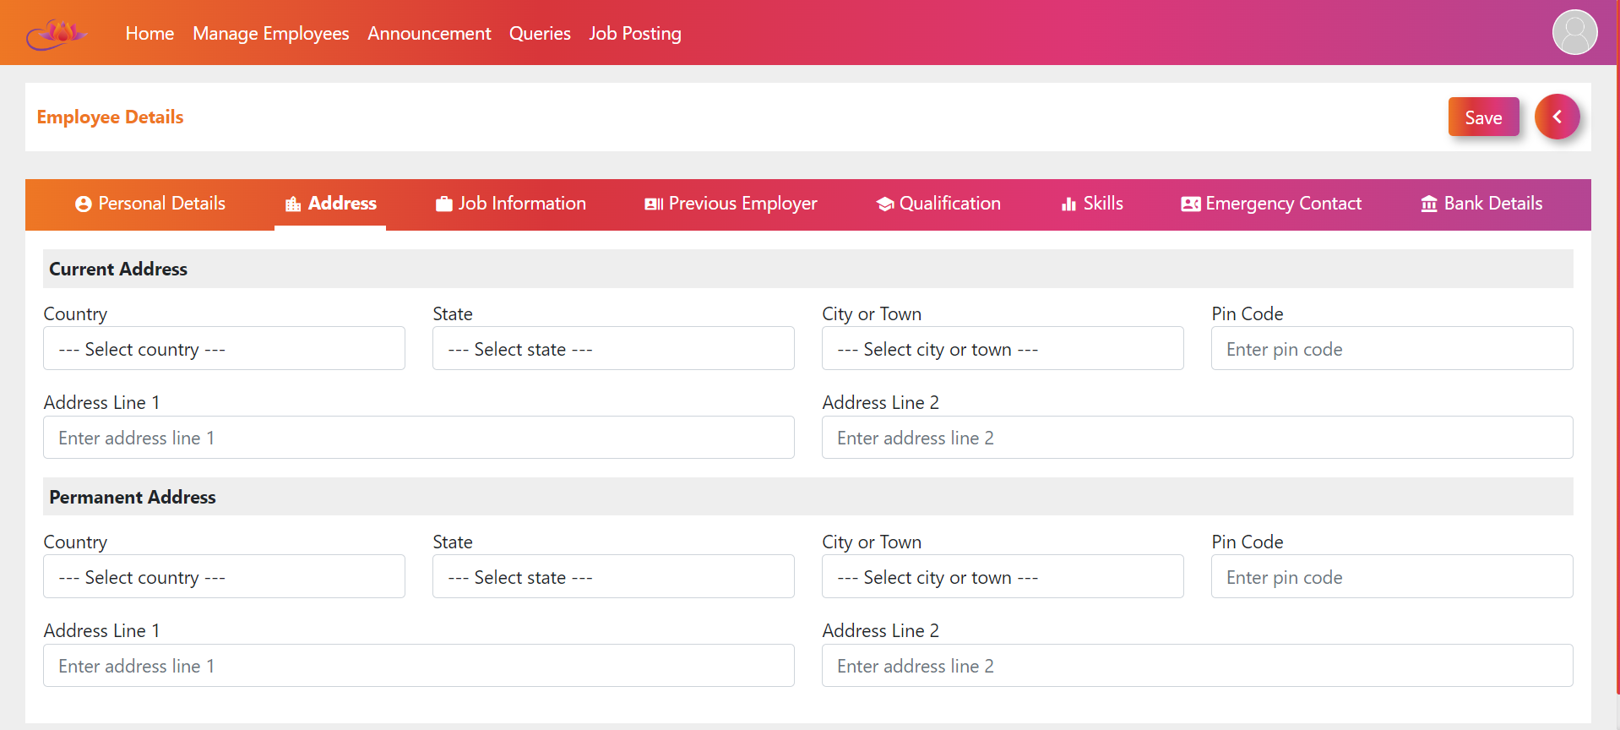

Slide 16
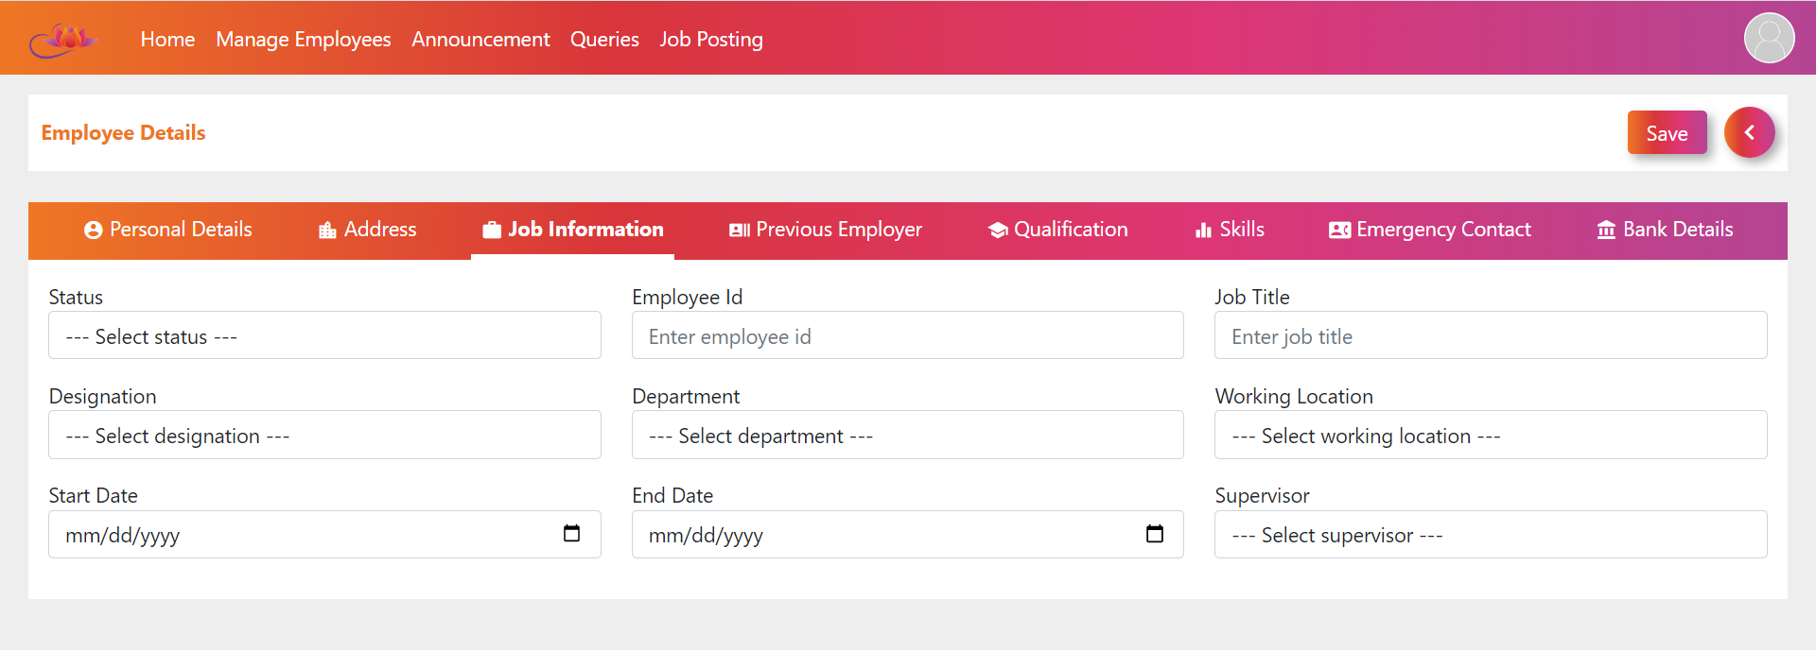

Slide 17
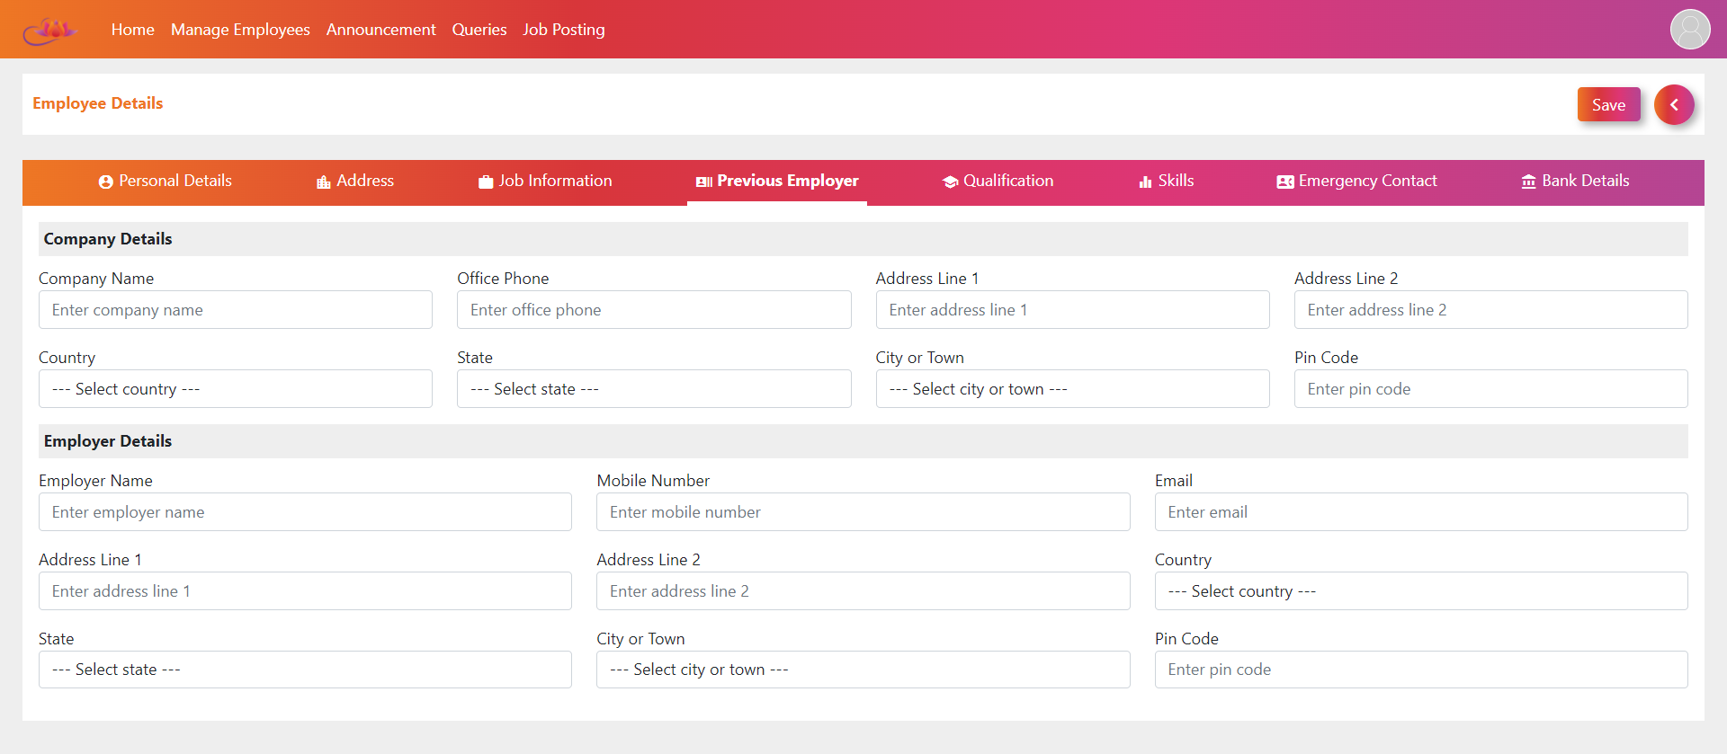

Slide 18
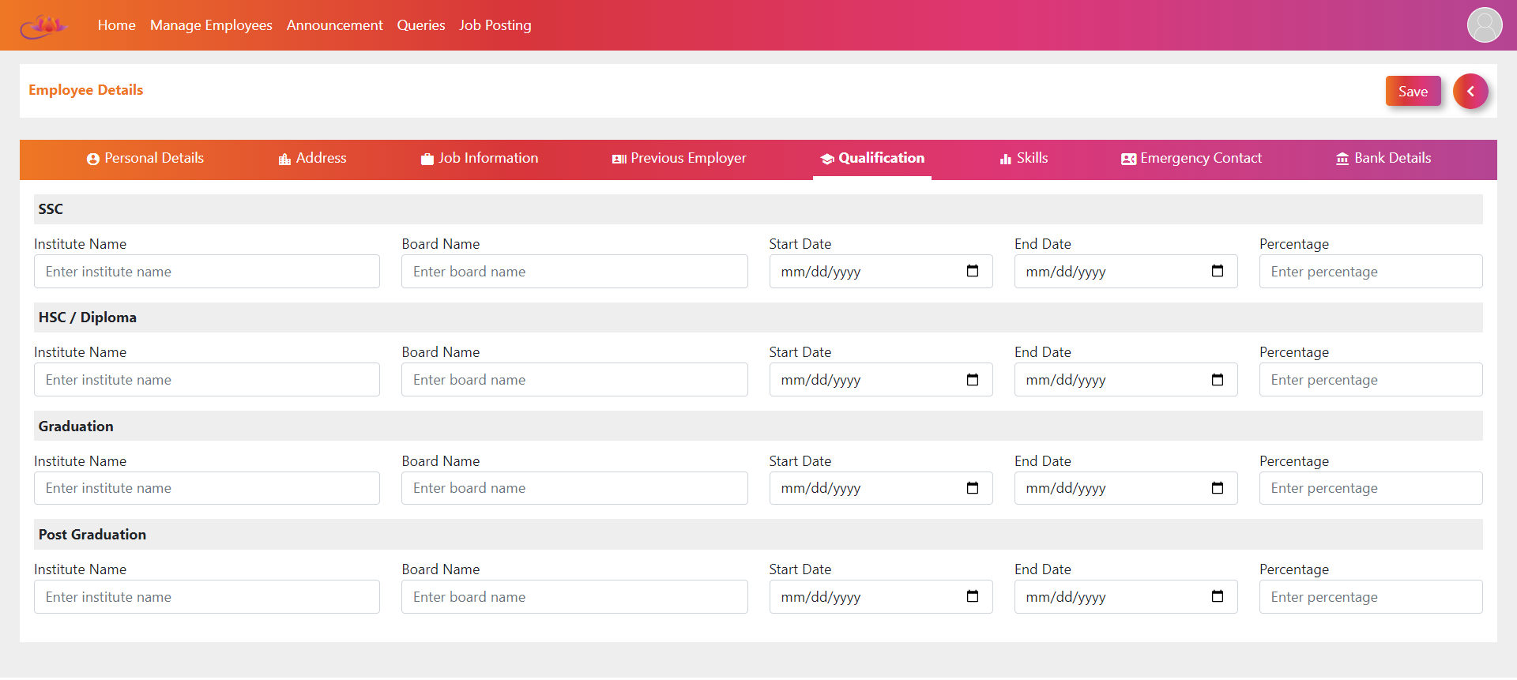

Slide 19
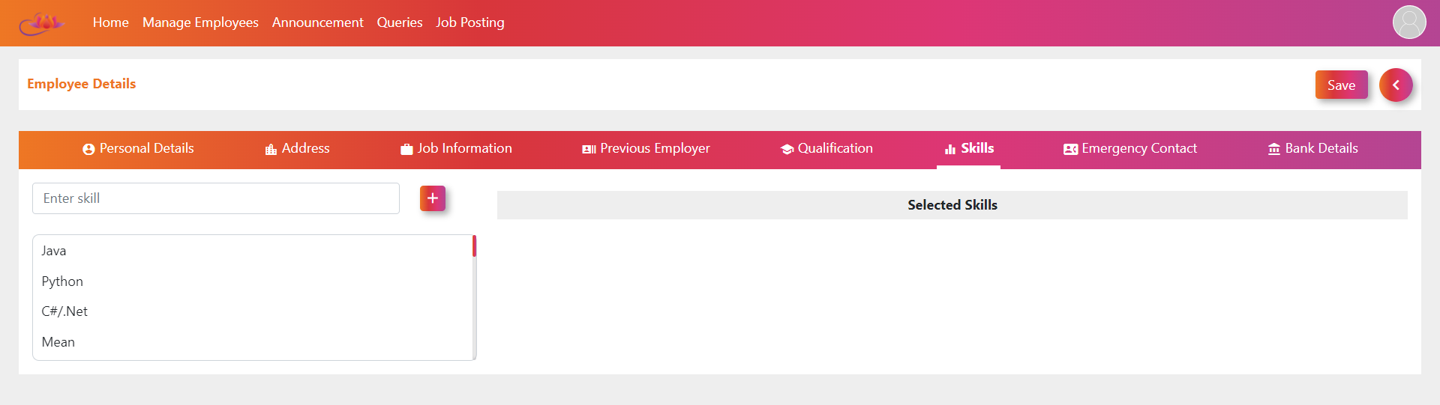

Slide 20
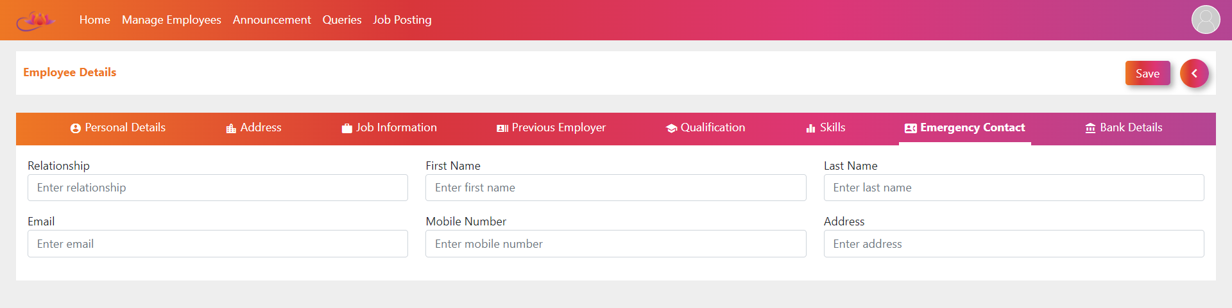

Slide 21
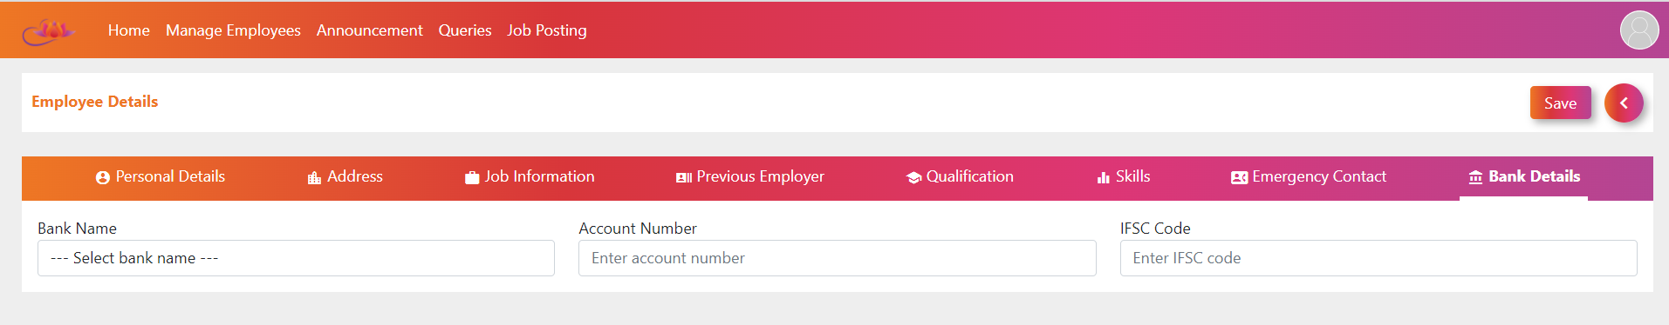

Slide 22
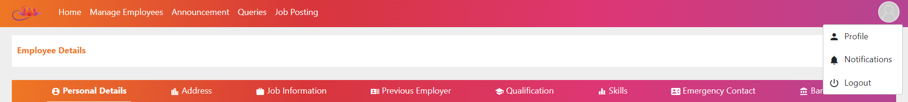

Slide 23
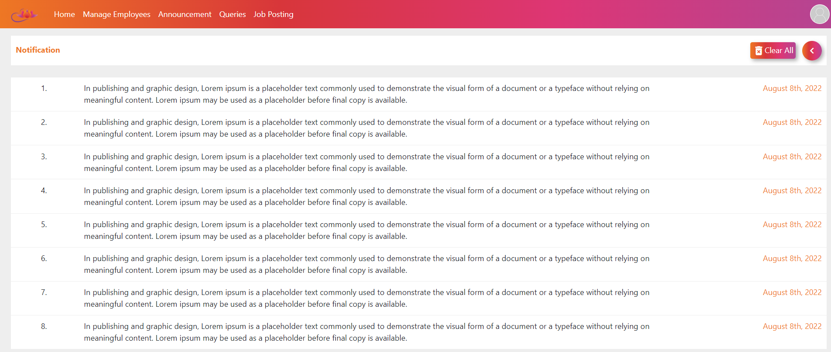

Slide 24
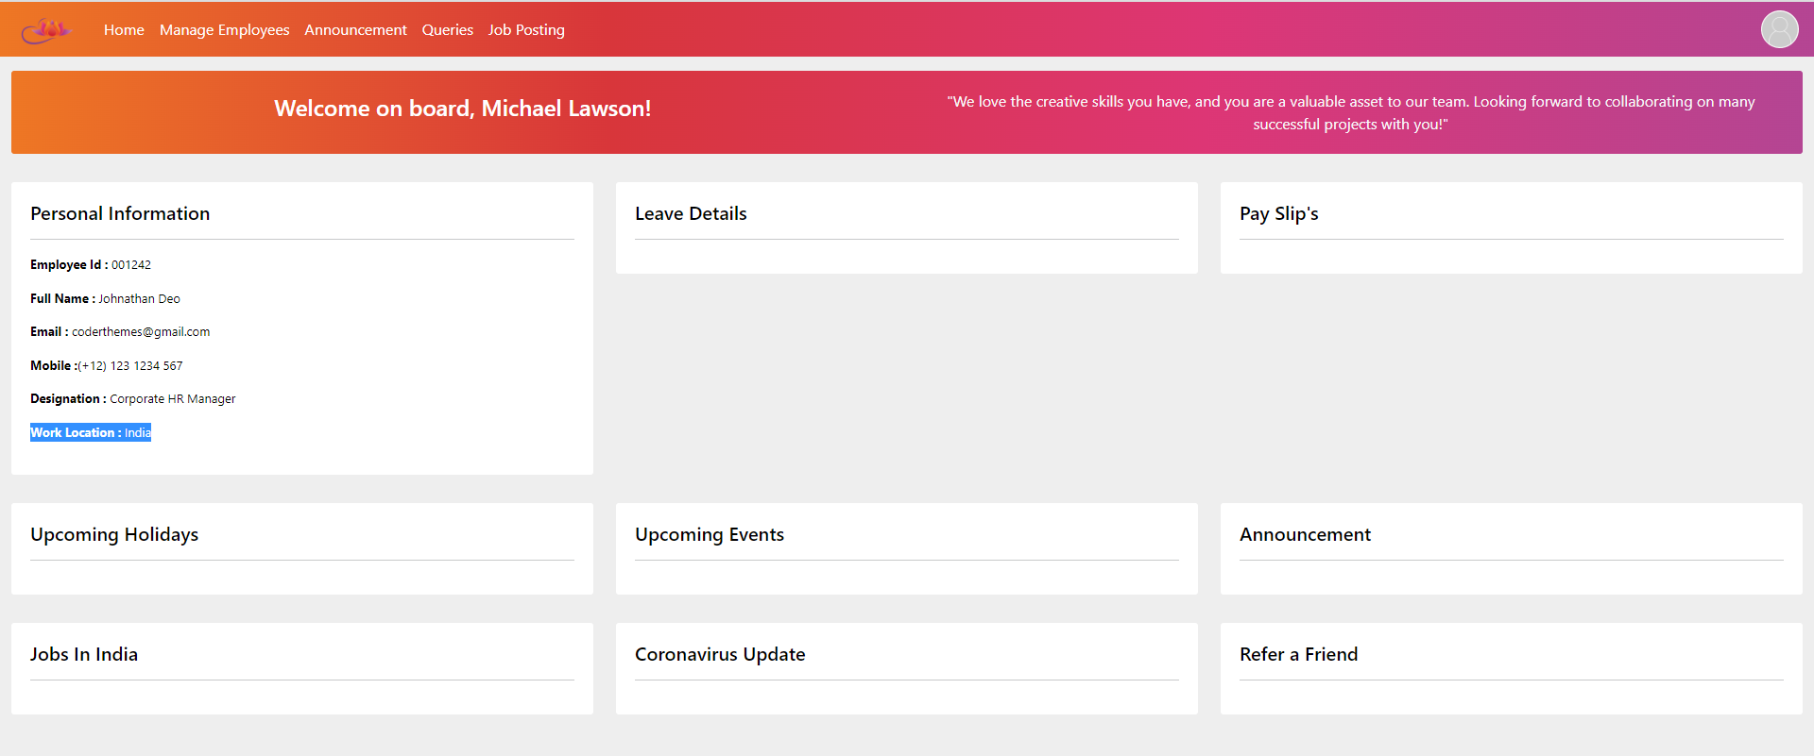

Slide 25
